Slide 1
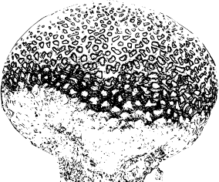

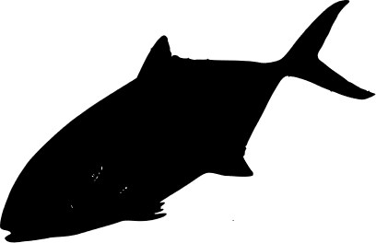
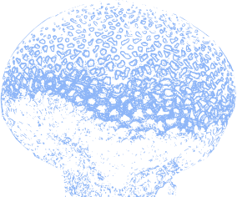
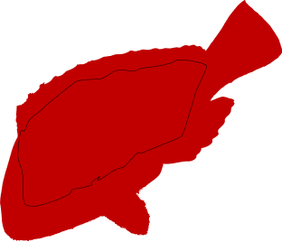

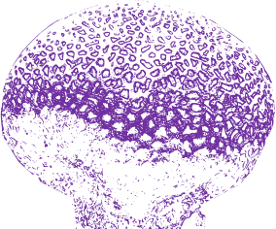
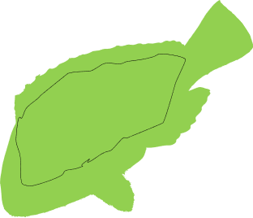

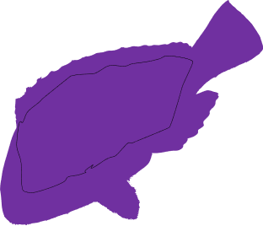
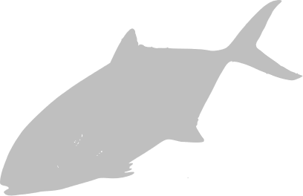
(a) Site occupancy modeling
Coral-associated fish
Co-occurring fish
Positive effect of coral cover, and neutral or negative effect of turf cover
Pearson’s correlation coefficient between species site occupancy probabilities equal or higher than 0.8
(b) Habitat - species network (under attack)
Indirect effect of coral loss
Subnetwork 1
Subnetwork 2
Direct effect of coral loss
t0
t1
… |A|
(c) Fish composition (node IDs) + fish functional traits
(d) Trait space analysis
(Area and occupancy)
(e) Network Robustness
Axis 2
Remaining fish TD
Remaining fish FD
Axis 1
t0, t1,
… |A|
Proportion of corals eliminated

